Slide 1
Software Standards for INS JWST Community Tools
Shannon Osborne and Matthew Bourque
February 17, 2022
Notes:
Matthew

Slide 2

Who We Are
Shannon Osborne Software Engineer II TEL/FGS
Matthew Bourque Senior Software Engineer MESA
Notes:
Matthew & Shannon (1 min)

Slide 3
Historical Context & Motivation
History:
In 2019, Jeff Valenti (and formally Margaret Meixner) and the JWSTMO kicked off an initiative to standardize the way INS-lead external JWST software tools are maintained and distributed
Goal:
To track software for the JWST user community that is developed and maintained by the Instruments Division (INS) and make it subject to a formal management process that ensures that the software is robust, maintainable, documented, and supported.
Specifically motivated by the opening of the JWST Cycle 1 Call for Proposals
Team:
Patrick Ogle and Bill Blair as Release Control Managers
Coordinate with SMO, WMO, JDox, Help Desk, and engineering. Authorize releases so they are not disruptive to ongoing activities
Matthew Bourque and Shannon Osborne as Software Development Leads
Set standards for INS software that is released to the community. Encourage a common approach across projects. Split standards into 2 “tiers” of more basic vs more advanced.
Notes:
Shannon (2-3 min)

Slide 4
The Tools and Teams (part 1/2)
Tool | Purpose | Maintainer(s) | Product Owner(s)
JWST Background Tool (JBT) | Determine background intensity and its components as a function of time to help with schedulability of JWST observations | Mees Fix Jesse Averbukh | Klaus Pontoppidan
JWST Interactive Sensitivity Tool (JIST) | Quick-look tool to explore the observation feasibility for basic observing modes | Brian York Jesse Averbukh | Klaus Pontoppidan
General/Moving Target Visibility Tool (G/MTVT) | Provides quick-look assessments of target visibilities and position angles for all instruments | Mees Fix Bryan Holler | Bill Blair John Stansbury
Coronagraphic Visibility Tool (CVT) | GUI-based tool for assessing target visibilities and position angles relative to MIRI and NIRCam coronagraphic masks | Mees Fix Bryony Nickson | Julien Girard
NIRSpec Observation Visibility Tool (NOVT) | Provides simultaneous view of NIRSpec & NIRCam FOV on a given sky position for planning NIRCam pre-imaging for NIRSpec | Emily Wislowski Maria Peña-Guerrero | Leonardo Ubeda
Notes:
Matthew (2 min)

Slide 5
The Tools and Teams (part 2/2)
Tool | Purpose | Maintainer(s) | Product Owner(s)
NIRSpec MSA Spectral Visualization Tool* | Visualize the layout of MOS spectra on the NIRSpec detectors, given a particular filter/disperser/MSA shutter config | Patrick Ogle | N/A (APT?)
Multi-Instrument Ramp Generator (MIRAGE) | Creates simulated data for a subset of the science observing modes for NIRCam and NIRISS, as well as imaging modes with FGS | Bryan Hilbert Camilla Pacifici | Bryan Hilbert
Advanced Webb Exposure Simulator for SOSS (awesimsoss)** | Given a 1D spectrum of a target, produces 2D SOSS ramp images for a specified number of groups and integrations | Joseph Filippazzo Néstor Espinoza | Joseph Filippazzo
WebbPSF | Computes simulated point spread functions for JWST and Roman | Marshall Perrin Shannon Osborne, Justin Otor | Marshall Perrin
Exoplanet Characterization Toolkit (ExoCTK) | Software package focused primarily on the characterization of exoplanets and time-series observation planning | Néstor Espinoza Matthew Bourque | Néstor Espinoza
* No longer supported ** awesimsoss has since been incorporated into MIRAGE
Notes:
Matthew (2 min)

Slide 6
Timeline
Sept 2019
July – Aug 2020
Nov - Dec 2019
Define Tier 1 standards and meet with JWSTMO
Define Tier 2 standards and meet with JWSTMO
Summer 2021
Meet individually with teams to discuss progress
Tier 2 Due Date
Cycle 1 Call For Proposals
JWST Launch
Oct 2019
Jan 2020
Sept 2020 – Jan 2021
Initial Meeting with the software teams
Tier 1 Due Date
Meet individually with teams to discuss standards and progress
Notes:
Shannon (2 min)

Slide 7
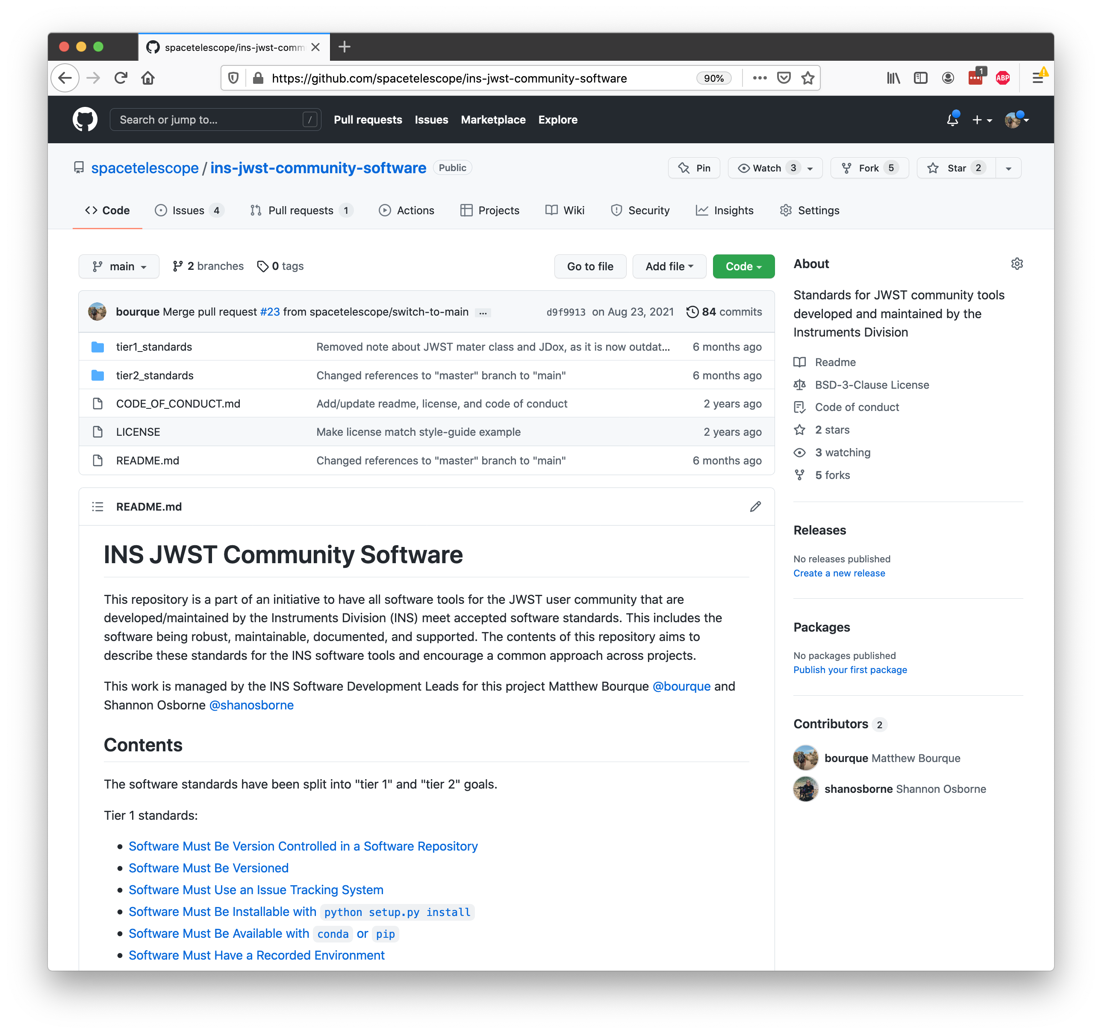
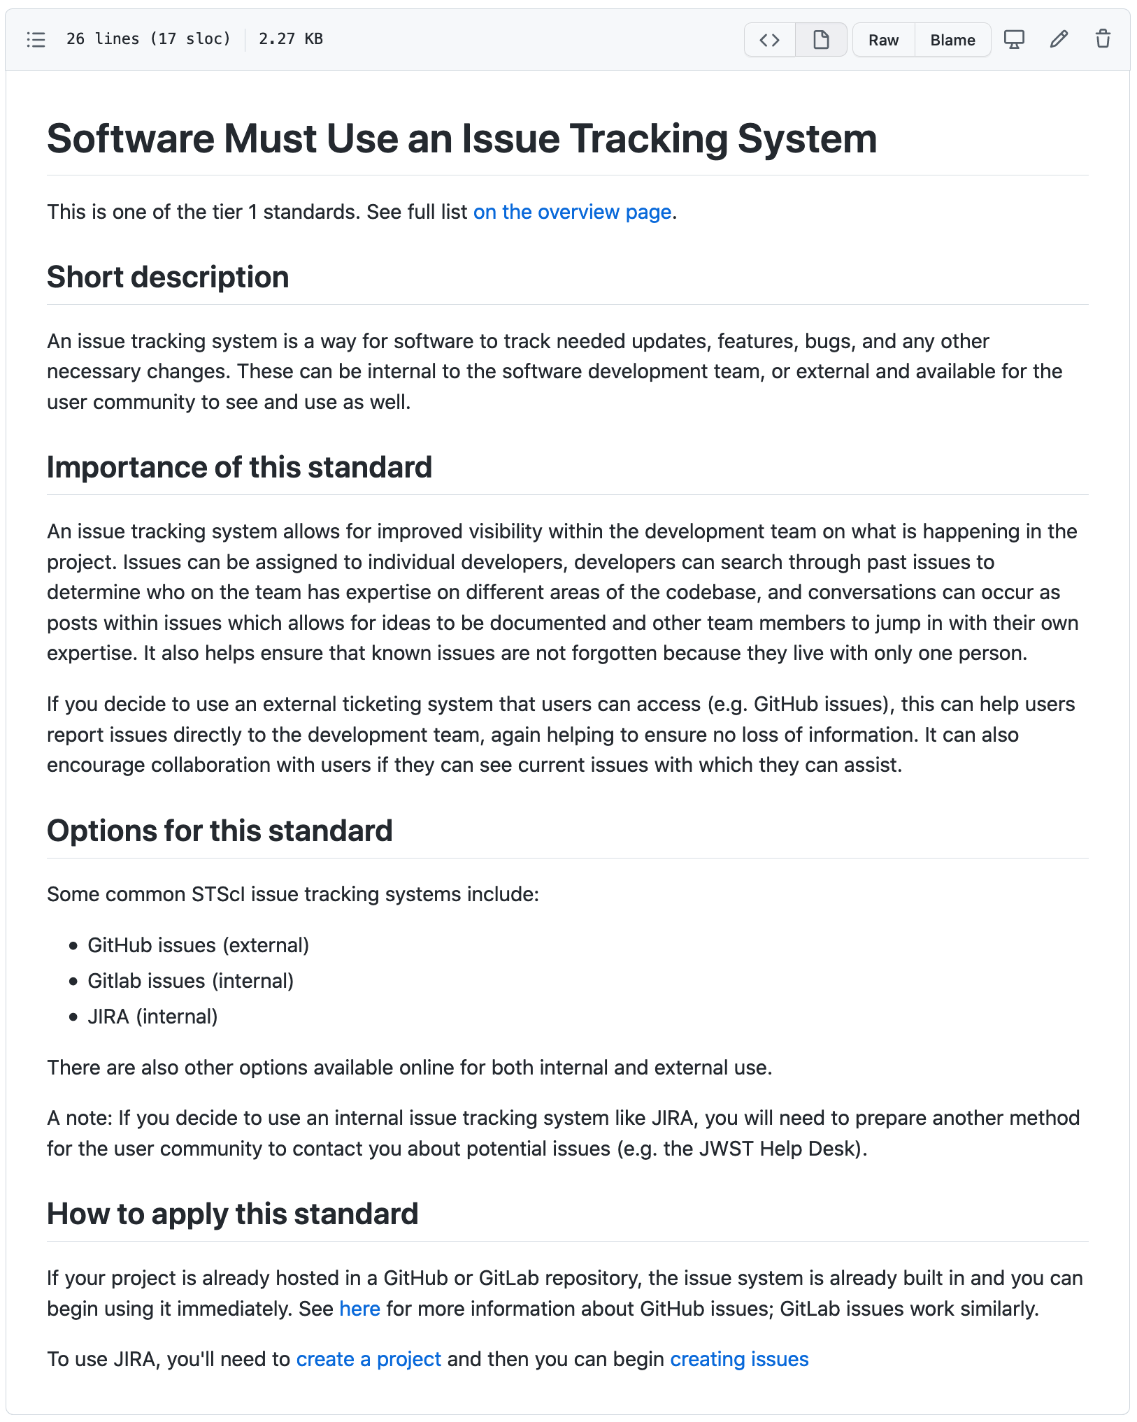
What We (Matthew and Shannon) Did
Notes:
Matthew (2 min)

Slide 8


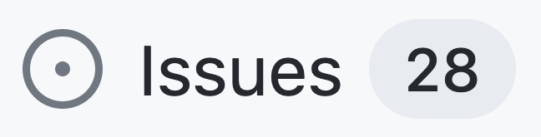



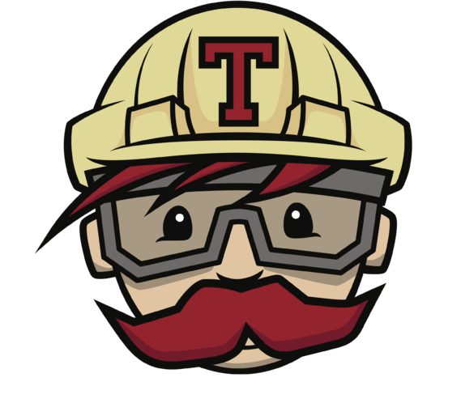



Tier 1 Standards – Standards to Help the Developers
Software Must Be Version Controlled in a Software Repository
Software Must Use an Issue Tracking System
Software Must Use Continuous Integration
Software Must Meet Basic Standards for Protecting It's main Branch
Software Must Have a LICENSE File
Software Must Meet Basic Security Standards
Notes:
Shannon (1 min)

Slide 9


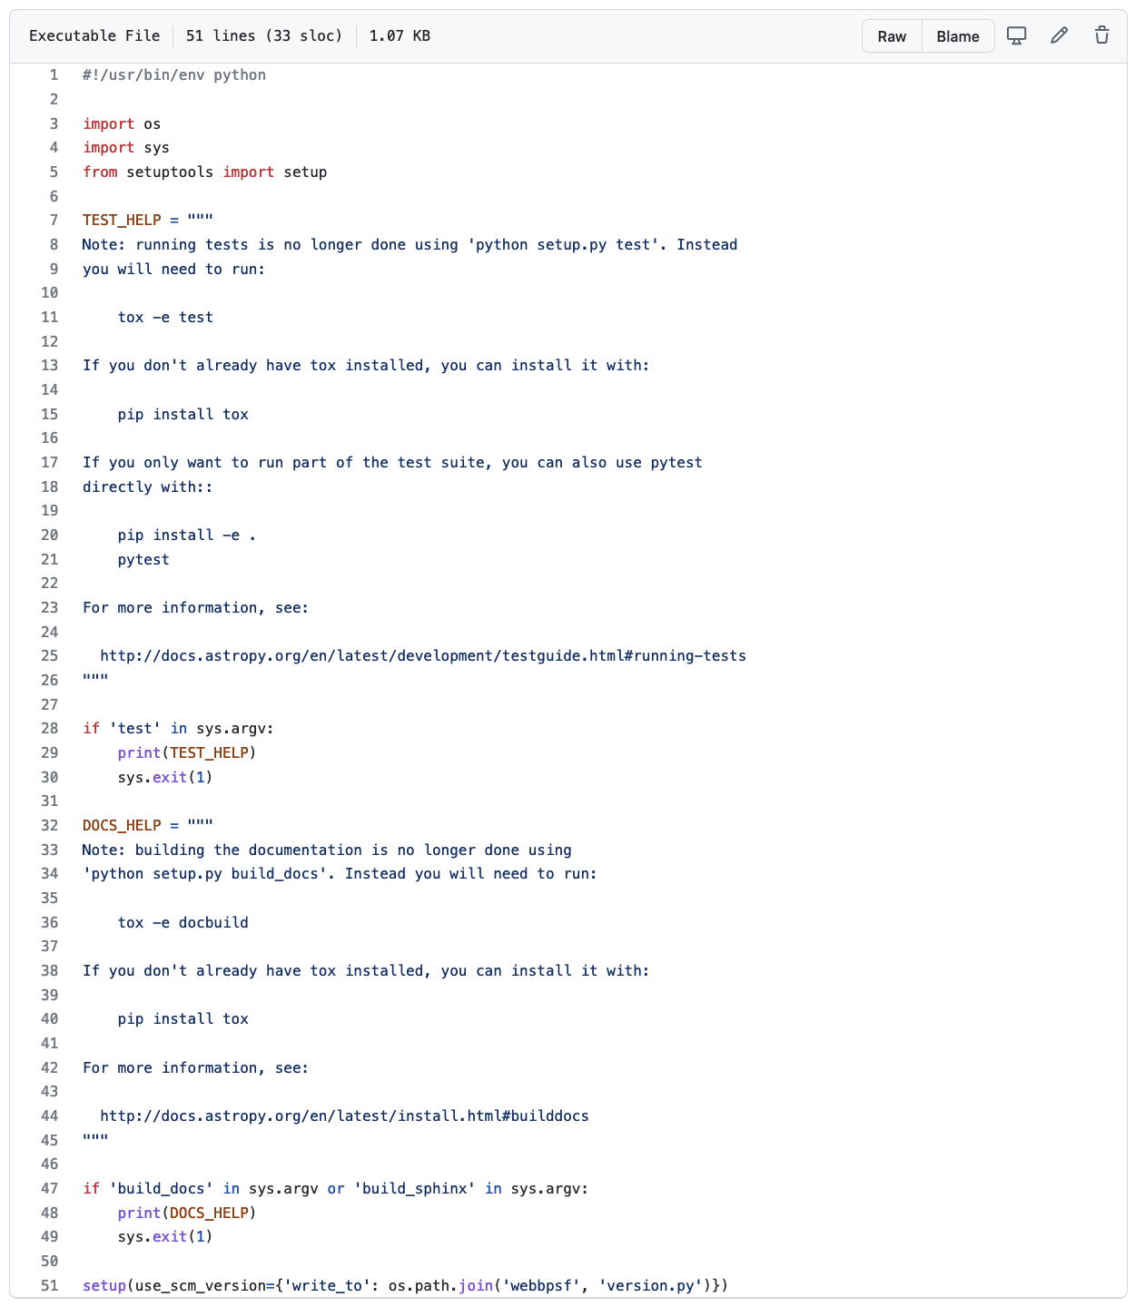
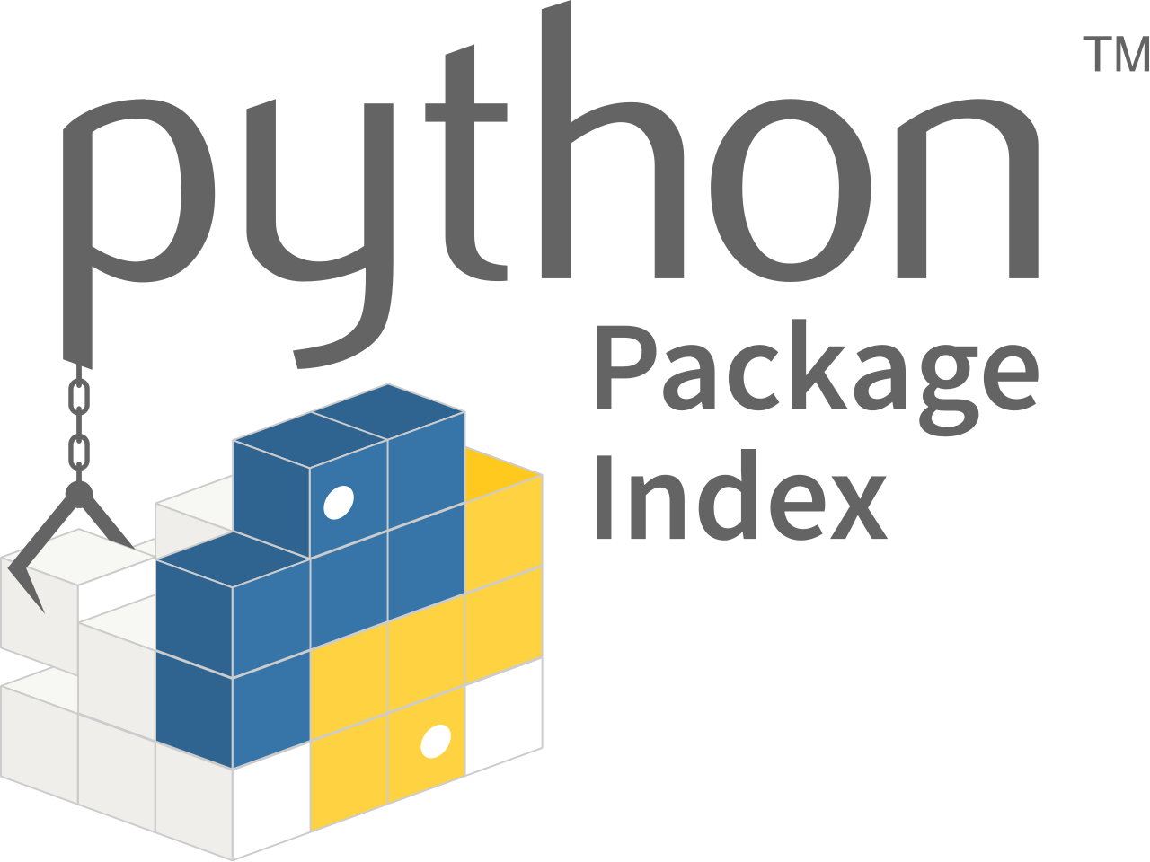
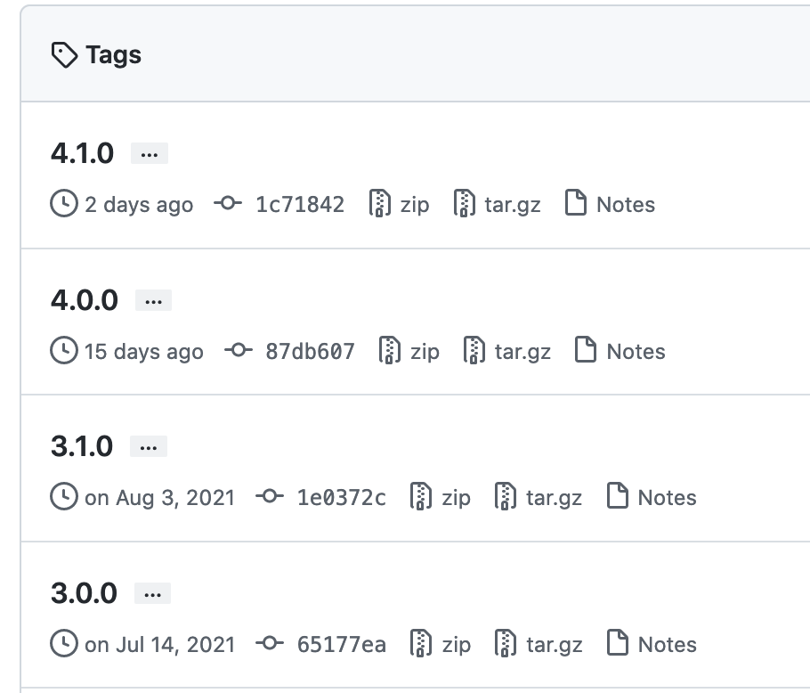




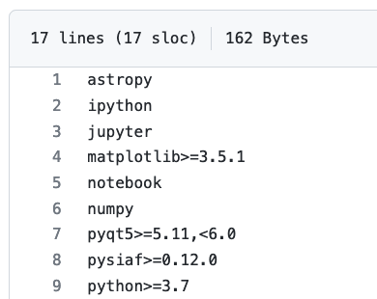

Tier 1 Standards – Standards to Help the Users
Software Must Be Installable with python setup.py install
Software Must Be Available with conda or pip
Software Must Have Installation and Usage Documentation
Software Must Have a Recorded Environment
Software must be versioned
Notes:
Shannon (1 min)

Slide 10

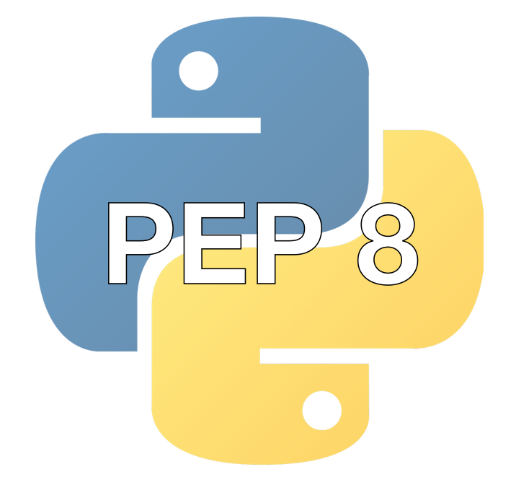
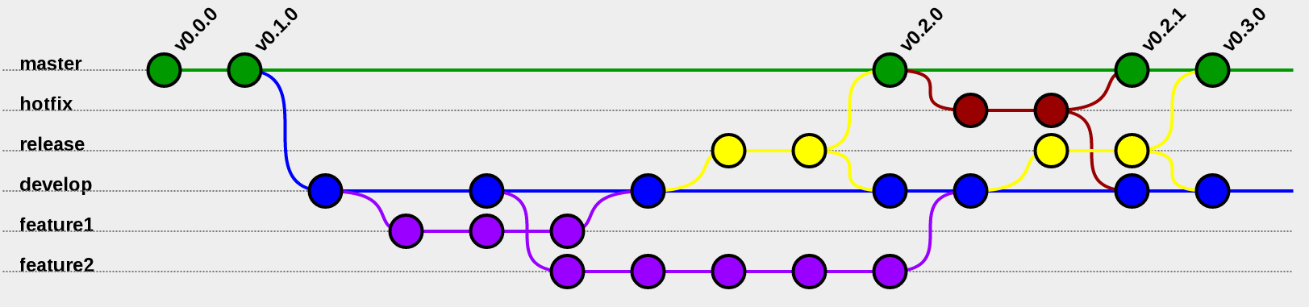
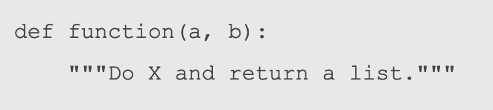


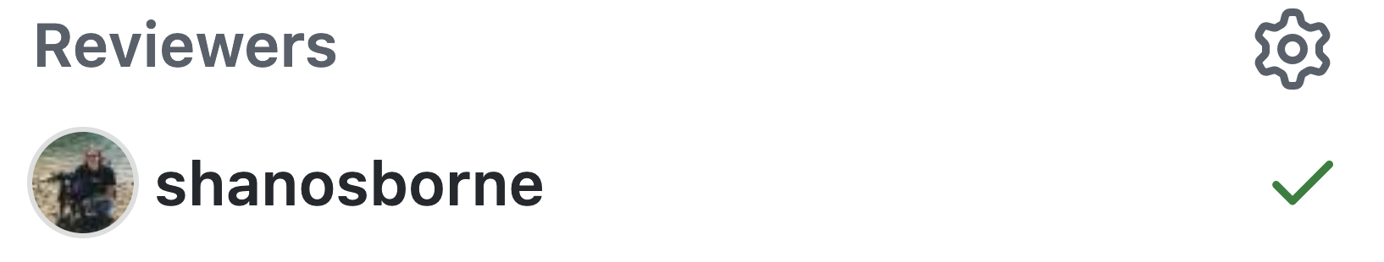


Tier 2 Standards – Standards to Help the Developers
Software Repository Must Have a Code of Conduct File
Software Must Enforce Language-specific Coding Standards (e.g. PEP8)
Project Must Have or Reference a Documented git Workflow or Contributor's Guide
Software Must Document Modules, Classes, and Functions
Project Must Have Some Unit and/or Regression Tests
Project Must Document a Release Procedure
Project Must Have Backup Maintainers
Project Must Utilize Code Review/Approval for New Changes
Project Must Use an Automated Dependency Update Tool
1.
2.
3.
Notes:
Shannon (1 min)

Slide 11






Tier 2 Standards – Standards to Help the Users
3.8
3.9
3.10
Project Must Document Citation Information
Software Must Support Recent Version(s) of Python
Project Must Provide Release Notes
Notes:
Shannon (1 min)

Slide 12
Before Tier 1 Implementation (circa ~October 2019)
Tier 1
JBT
JIST
JWST G/MTVT
CVT
NOVT
NIRSpec MSA Spec Viz Tool
MIRAGE
awesimsoss
WebbPSF
ExoCTK
Not Applicable
Completed
Missing
No Longer Supported
Notes:
Matthew (1 min)

Slide 13
After Tier 1 Implementation (circa ~January 2020)
Tier 1
JBT
JIST
JWST G/MTVT
CVT
NOVT
NIRSpec MSA Spec Viz Tool
MIRAGE
awesimsoss
WebbPSF
ExoCTK
Not Applicable
Completed
Missing
No Longer Supported
Notes:
Matthew (1 min)

Slide 14
Before Tier 2 Implementation (circa ~September 2020)
Tier 1
Tier 2
JBT
JIST
JWST G/MTVT
CVT
NOVT
NIRSpec MSA Spec Viz Tool
MIRAGE
awesimsoss
WebbPSF
ExoCTK
Not Applicable
Completed
Missing
No Longer Supported
Notes:
Matthew (1 min)

Slide 15
After Tier 2 Implementation (circa ~September 2021)
Tier 1
Tier 2
JBT
JIST
JWST G/MTVT
CVT
NOVT
NIRSpec MSA Spec Viz Tool
MIRAGE
awesimsoss*
WebbPSF
ExoCTK
Not Applicable
Completed
Missing
No Longer Supported
* awesimsoss has been incorporated into MIRAGE
Notes:
Matthew (1 min)

Slide 16
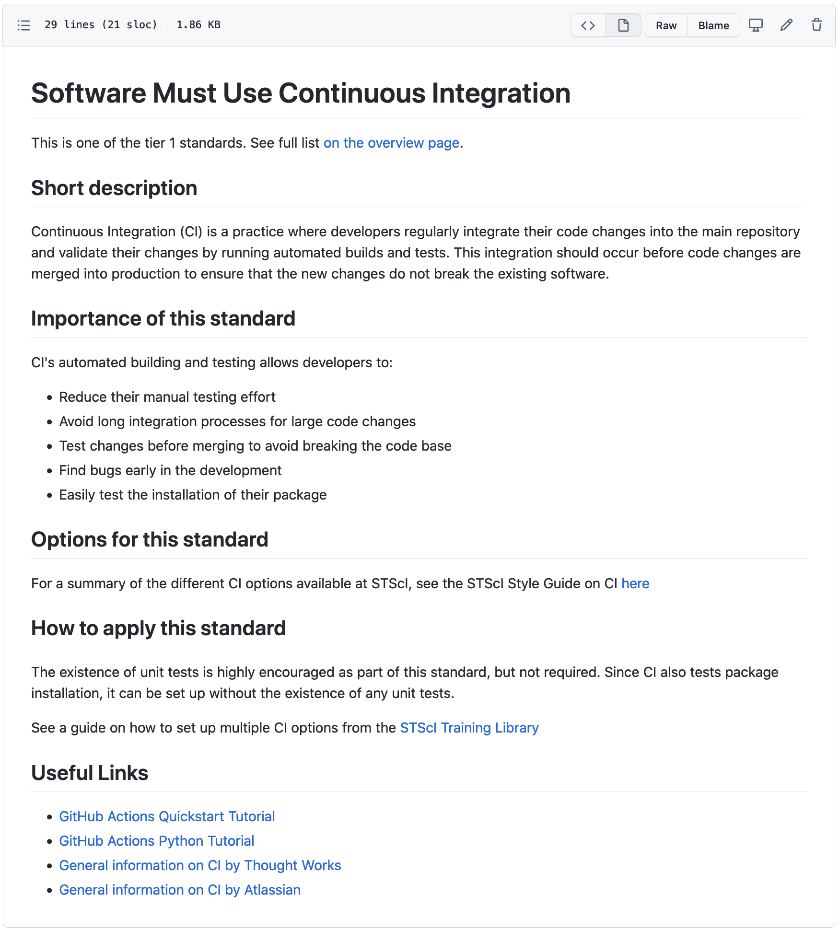
Applications for Other Tools & Future use
The GitHub repository is public and is available for anyone actively developing a tool or who wants to build a new tool
Mostly static at this point
Links will be on the next slide
This information could also be combined with the STScI style guides, but since there is no active development team on the style guides, it would have to come from someone else with the time to integrate them.
Notes:
Shannon (1-2 min)

Slide 17
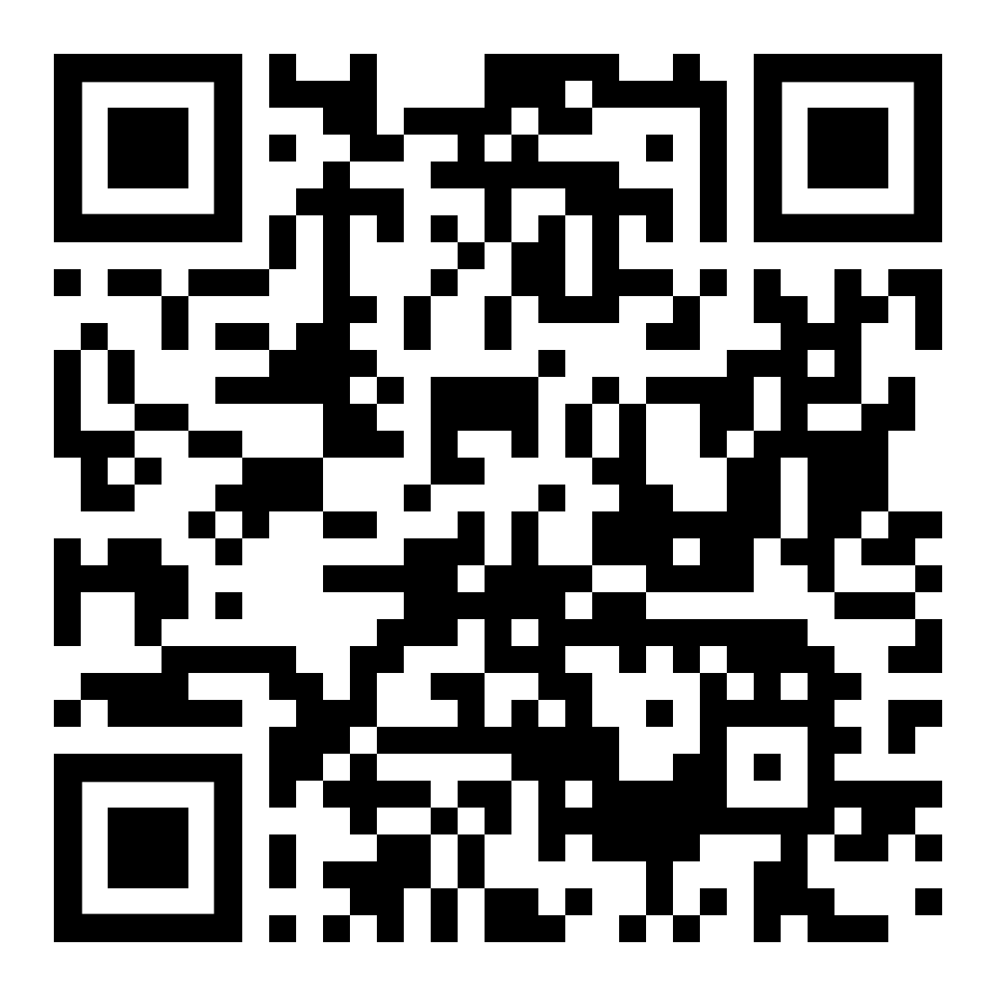
Links to relevant documentation
GitHub Repository:
https://github.com/spacetelescope/ins-jwst-community-software
INS JWST Community Tools Hub on Innerspace:
https://innerspace.stsci.edu/display/JWST/INS+Software+for+the+Community
WIC (Webb INS Coordination) Tasks:
https://innerspace.stsci.edu/display/WIC/Task-092
https://innerspace.stsci.edu/display/WIC/Task-176
STScI Style Guides:
https://github.com/spacetelescope/style-guides/
GitHub Repository
Notes:
Matthew (<1 min)

Slide 18
Acknowledgements
Jesse Averbukh
Bill Blair
Néstor Espinoza
Joseph Filippazzo
Mees Fix
Alex Fullerton
Julien Girard
Maria Peña-Guerrero
Bryan Hilbert
Bryan Holler
Bryony Nickson
Patrick Ogle
Camilla Pacifici
Marshall Perrin
Klaus Pontoppidan
John Stansberry
Leonardo Ubeda
Jeff Valenti
Emily Wislowski
Brian York
GitHub Repository
Notes:
Matthew (<1 min)

